Slide 1
Service guard Presentation
Securing service guard clusters
Yershki,Fabien,thibaut,francis

Slide 2
Summary
Introduction of service guard
Problems identified
Actions to resolve problems
Load and deadlines of the project
Division of task between stakeholders

Slide 3
Why do we use service guard ?
Applications running on servers
High availability
Load balancing

Slide 4
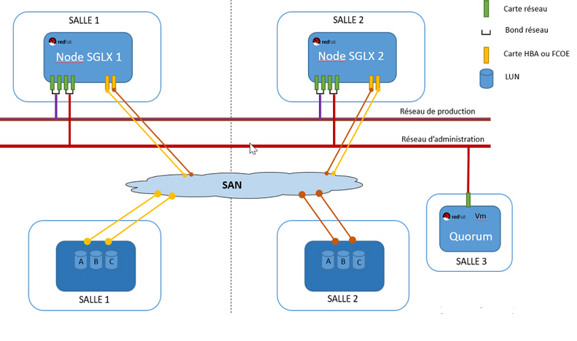
Example

Slide 5
Problems identified
Problem 1: Machine obsolescence (RedHat6 and RedHat7)
Problem 2: MDADM instability
Issue 3: Lack of package management
Issue 4: Installation of service guard is not automated
Issue 5: Lack of supervision on Service Guard
Issue 6: Loss of network interface

Slide 6
Actions for problem resolution
Action 1: Migration of quorum on redhat8
Action 2: Migration of servers from MDADM to LVM
Action 3: Reboot script for better package management
Action 4: Automate the installation of Service Guard on ansible
Action 5: Testing compatibility of service guard 1260 on RedHat8

Slide 7
Actions for problem resolution
Action 6: Set up ServiceGuard Dashboard
Action 7: Deployment of Zabbix plugins for monitoring
Action 8: Adding RAM on PSI
Action 9: Firmware Update
Action 10: Bonding heartbeat for high availability

Slide 8
Loads and deadline of the project
Load of the project : 346 days + 10% of safety margin = 381 days
Deadline of the project : End of December 2022

Slide 9
Division of task
Stakeholders | Actions
Fabien ZIMMER | Migration of mdadm to lvm Automation of service guard installation (ansible) Setting up service guard dashboard
Thibaut CACHE | Reboot script for better package management Deployment of zabbix plugin Firmware update Adding RAM for PSI
Francis FACHINAN | Quorum migration on Redhat8 Testing service guard compatibility on redhat8 Setting up bonding of heartbeat

Slide 10
Fabien zimmer
Migration of MDADM to LVM

Slide 11
Francis fachinan
Quorum migration on redhat8

Slide 12
Thibaut Cache
Script reboot for package management
Plugin zabbix for monitoring
Adding RAM for PSI

Slide 13
End of presentation Thank you for your attention

